Slide 1
HL78xx – Collecting ModemFW logs
How to collect ModemFW with TeraTerm - R00.01

Slide 2
Prerequisites
Host
  Windows 7, Windows 8, Windows 8.1 or Windows 10
  Install FTDI VCP drivers if needed (http://www.ftdichip.com/Drivers/VCP.htm)
  Tera Term serial tool available here
Device
  AHL78xx.1.4.4.0 FW Release (or newer)
  HL78xx LOG Traces activated (AT+SWITRACEMODE=LOG)

Slide 3
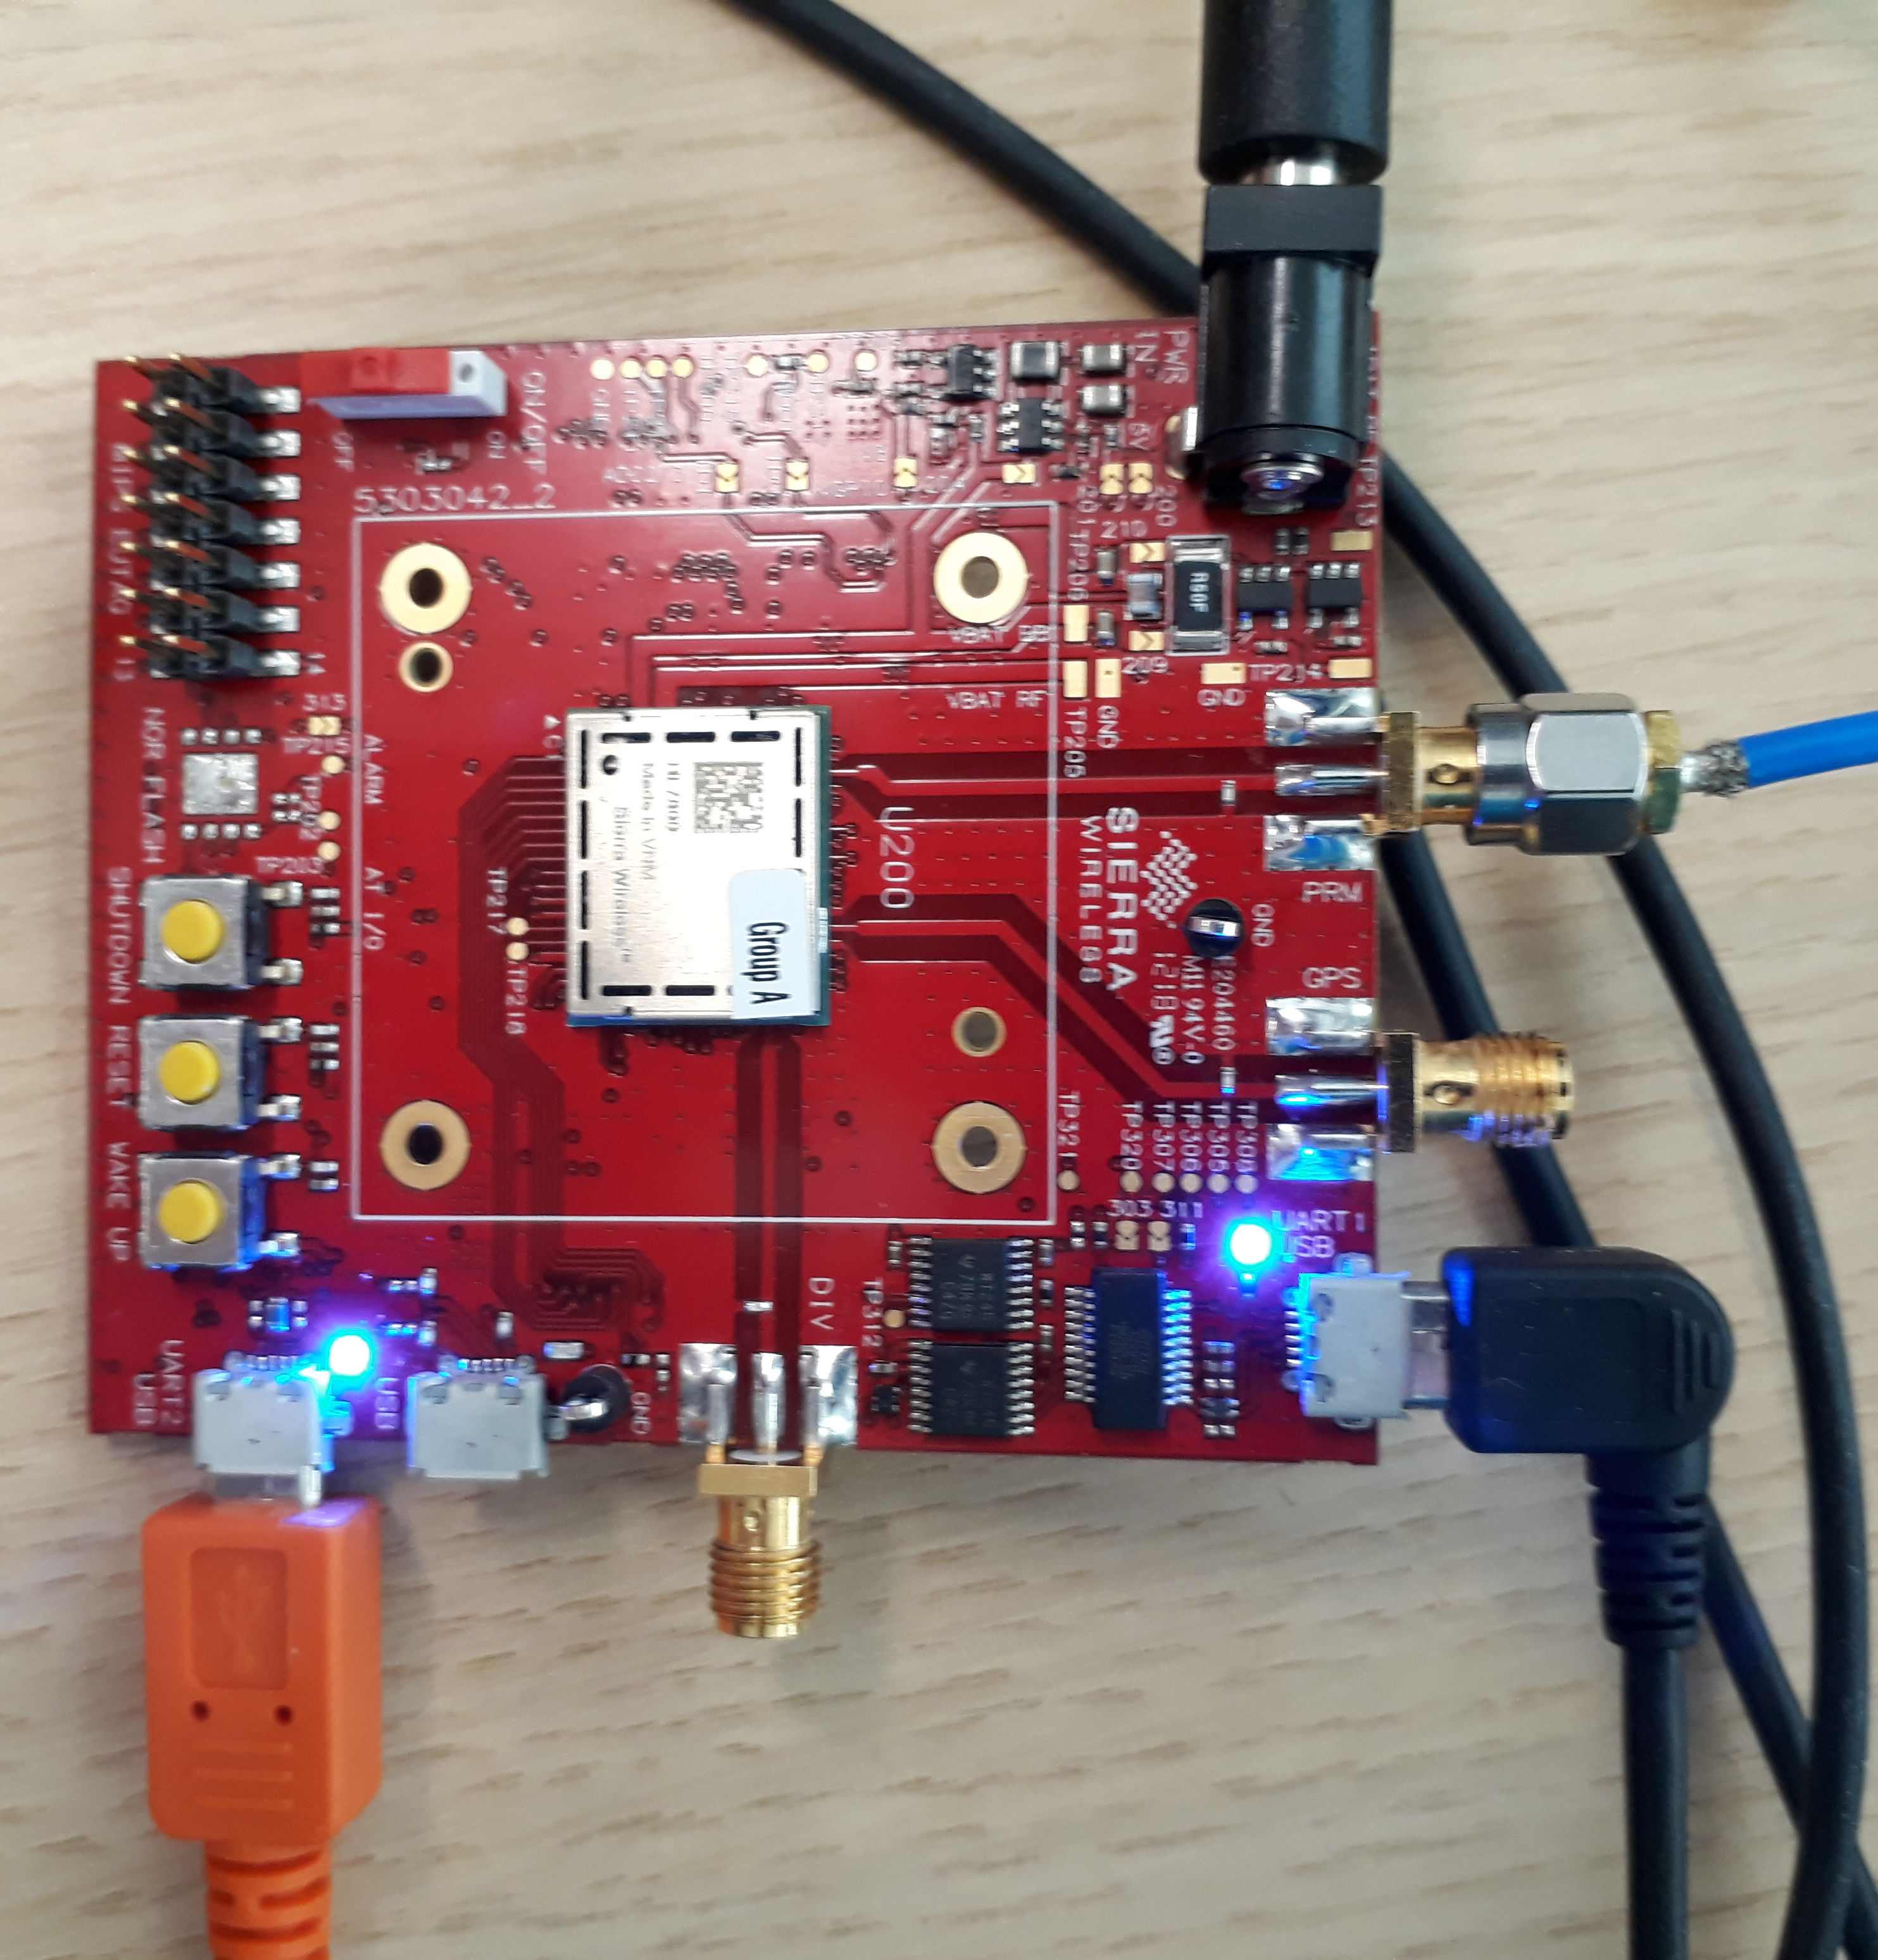
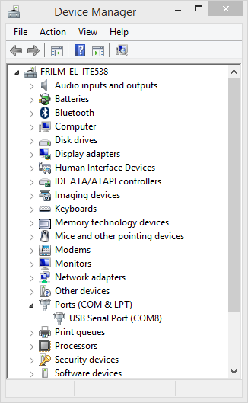
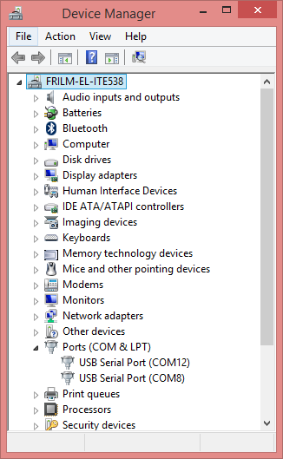
Connection between device and host
2 USB cables needed
  One for AT UART
  One for Debug UART
    ModemFW logs will be retrieved from this UART
Interfaces seen on host side
  When AT UART is connected to the host, a first Virtual COM port is created
    Note the COM port number (here COM8)
  When Debug UART is connected to the host, a second Virtual COM port is created
    Note the COM port number (here COM12)
Debug UART
AT UART

Slide 4
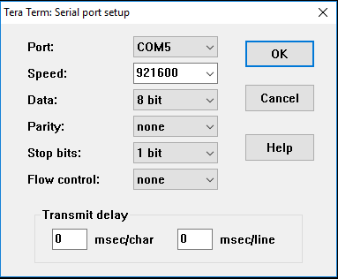
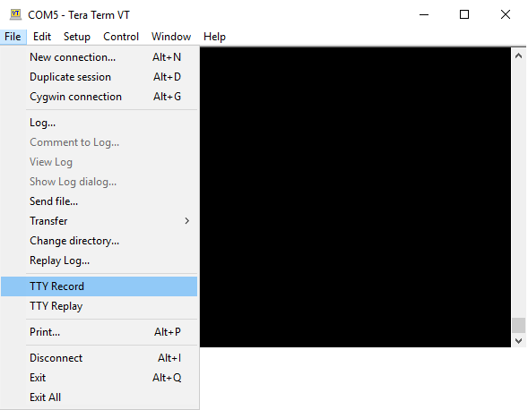
Logs configuration on host side
Launch TeraTerm
  Go to “Setup” and “Serial port”
  Port: COM used and selected must be the UART 0 (Debug UART)
  Speed: Must be set to 921600
Logs file creation
  Go to “TTY recording selection” → The logs are saved in a file with .tty extension <log_file>.tty for example
After logs collection done, rename .tty extension to .bin and provided the <log_file>.bin for analysis

